Slide 1
Social Sciences and Humanties Open Cloud
Realising the Social Sciences and Humanities part of the European Open Science Cloud

Slide 2









Project:
Type of action & funding:
Research and Innovation action
(INFRAEOSC-04-2018)
Partners: 47
(20 beneficiaries + 27 LTPs)
SSH ESFRI Landmarks and Projects
& international SSH data infrastructures
Project budget:
€ 14,455,594.08
Project website: www.SSHOpenCloud.eu
Duration: 40 months
(January 2019 – 30 April 2022)
Objectives:
creating the social sciences and humanities (SSH) part of European Open Science Cloud (EOSC)
maximising re-use through Open Science and FAIR principles (standards, common catalogue, access control, semantic techniques, training)
interconnecting existing and new infrastructures (clustered cloud infrastructure)
establishing appropriate governance model for SSH-EOSC

Slide 3
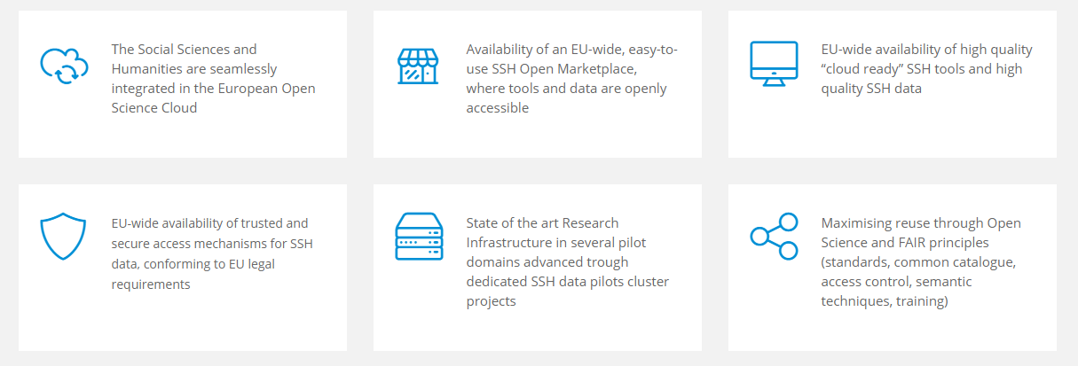
Expected impact

Slide 4
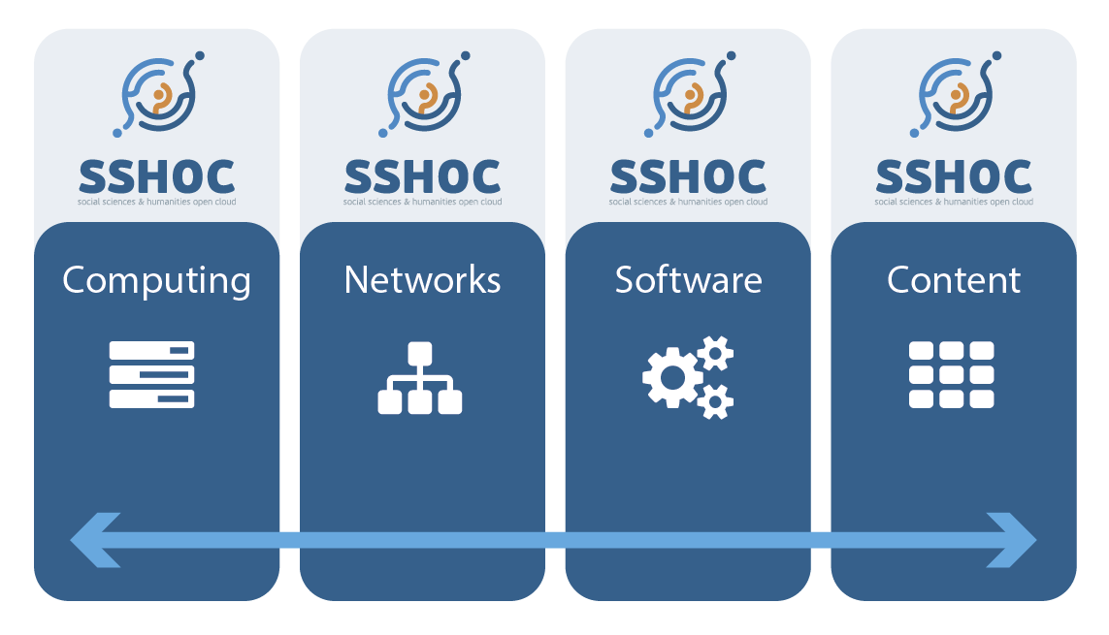
Transition from disciplinary silos and separate e-infrastructures into cloud-based infrastructure for scholars
With FAIR data & Tools and Training Services

Slide 5
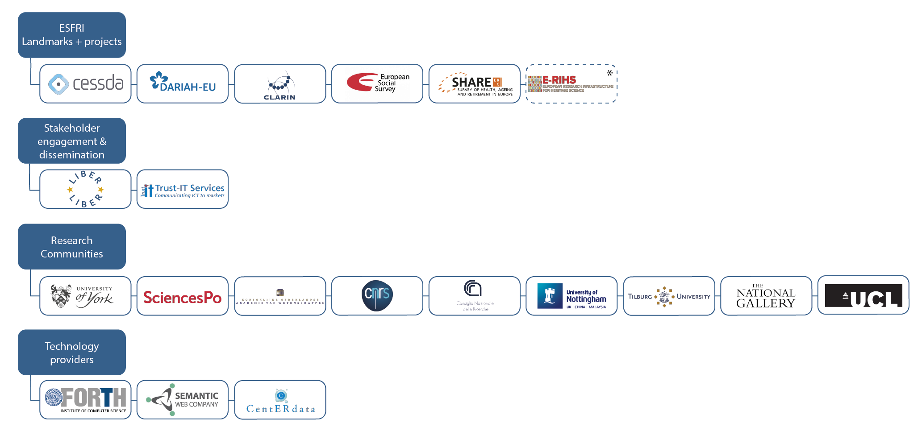
SSHOC Partners
*E-RIHS is not a legal partner in the SSHOC project but we connect to the E-RIHS community through the Institutum Archaeologicum Germanicum.

Slide 6
SSHOC consortium covers the whole data cycle
Following the FAIR Principles
Archiving
Concept
Collection
Processing
Distribution
Discovery
Analysis
Repurposing

Slide 7
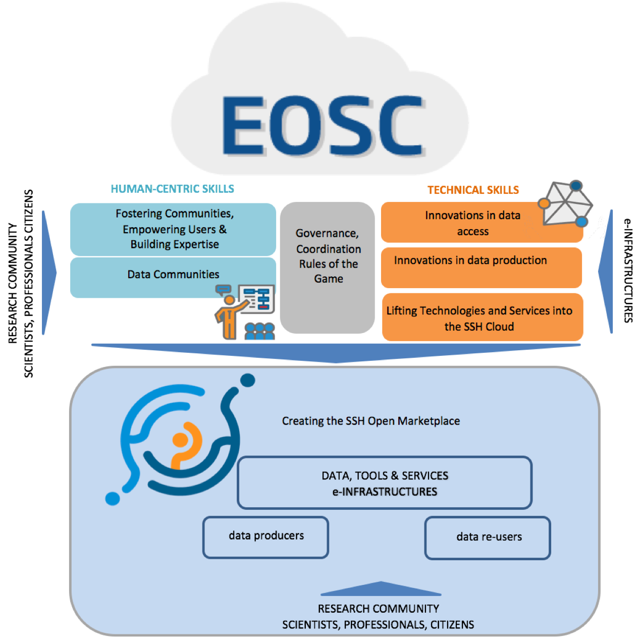
Elements of SSHOC and how work comes together
Research (data) communities
e-Infrastructures
Innovation
Training
Tools
Marketplace
Governance

Slide 8
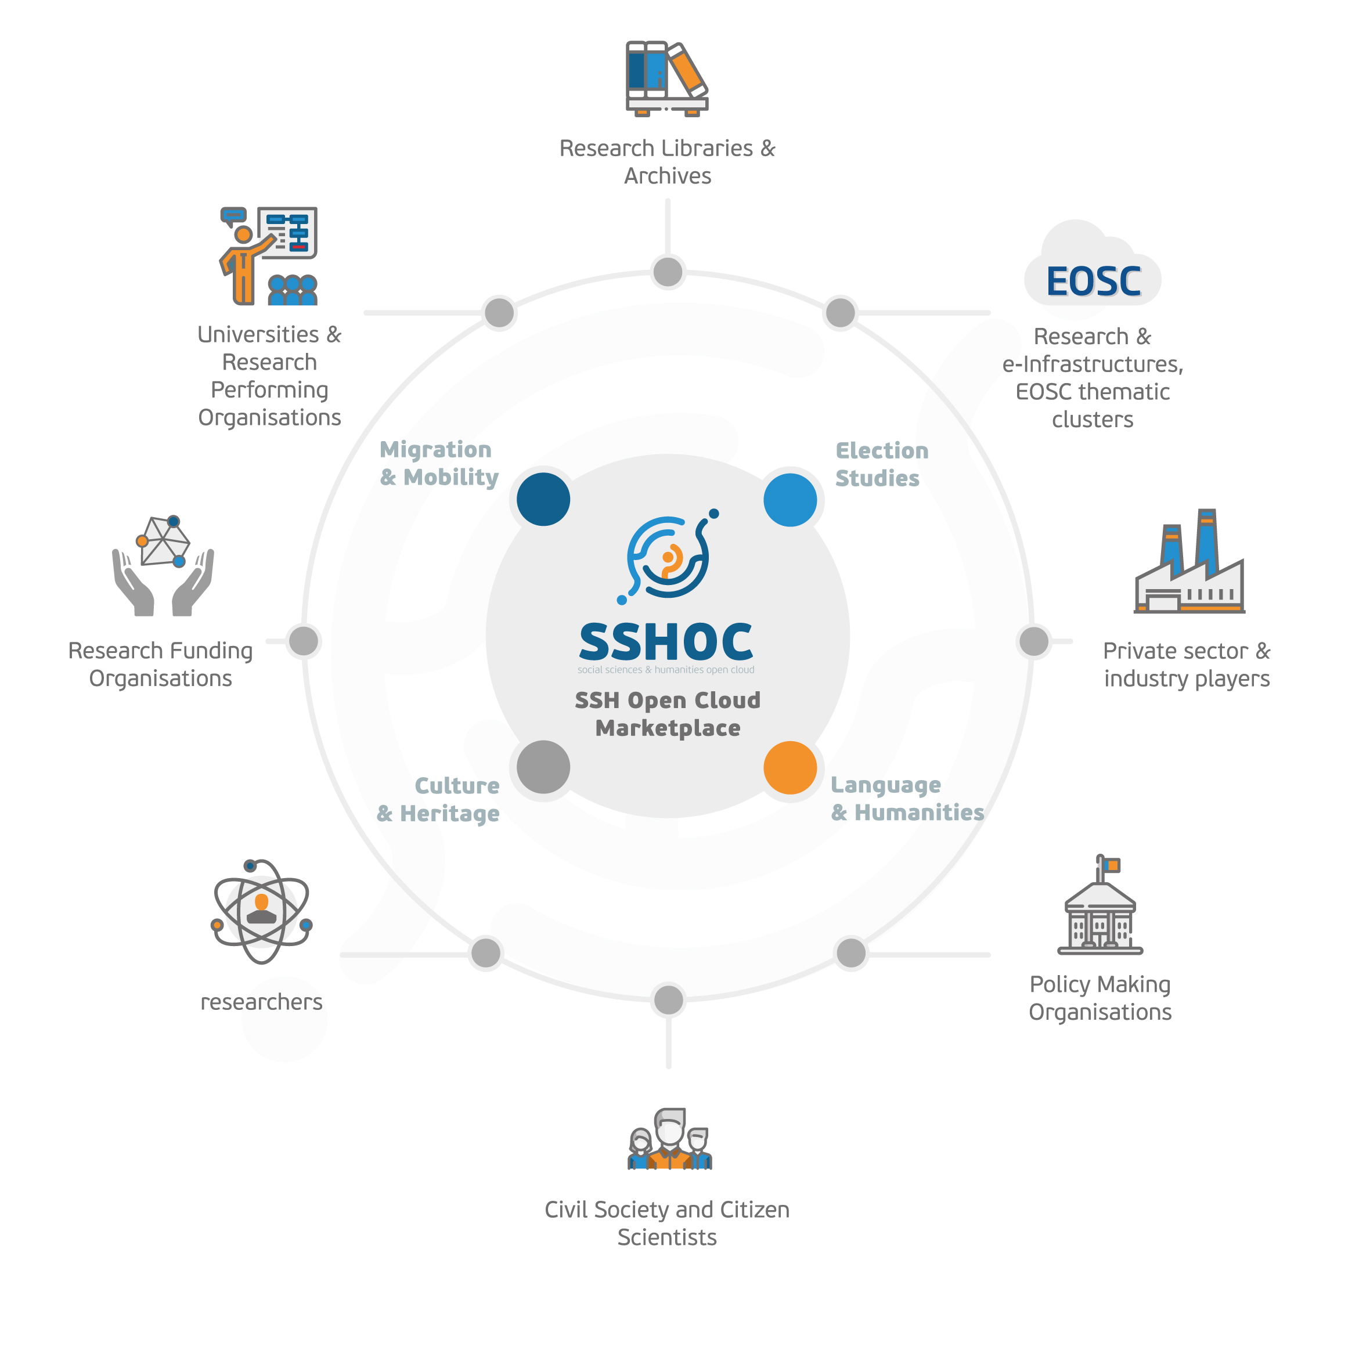


SSHOC Stakeholders and offering
On- and offline trainings and training materials and an international cross-disciplinary trainer network
Availability of an EU-wide, easy-to-use SSH Open Marketplace, where tools and data are openly accessible

Slide 9




Join our community!
www.sshopencloud.eu
@SSHOpenCloud
/in/sshopencloud
info@sshopencloud.eu

